Slide 1
Shear Viscosity of Colloidal Suspensions

Slide 2
Simulated System
Implemented a shearing DPD simulation with equations and dynamics from Pryamitsyn
Viscosity is calculated with a Lees-Edwards system, shear stress is computed and then the integral of this stress autocorrelation function is computed

Slide 3

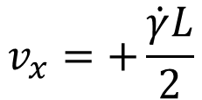


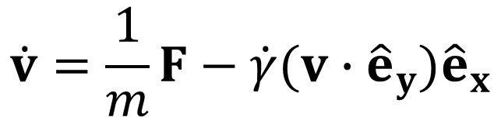
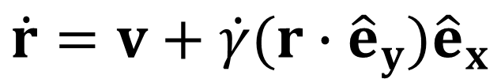
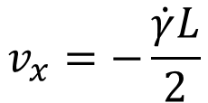
Simulated System
$$y$$
$$x$$
$$v_{x}=+\frac{\dot{γ}L}{2}$$
$$\dot{r}=v+\dot{γ}(r∙{\hat{e}}_{y}){\hat{e}}_{x}$$
$$L$$
$$\dot{v}=\frac{1}{m}F−\dot{γ}(v∙{\hat{e}}_{y}){\hat{e}}_{x}$$
$$v_{x}=−\frac{\dot{γ}L}{2}$$

Slide 4
Interaction Forces
DPD Forces between fluid particles
Inclusive of rotation – Each particle has a velocity and also an angular velocity
Particles can exert off-axis forces and torques on one another
Lennard-Jones potential for fluid-colloid and colloid-colloid pairs
Fluid-colloid potential is much softer than the colloid-colloid pairs

Slide 5
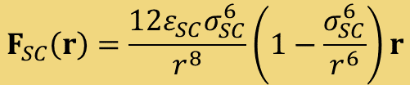

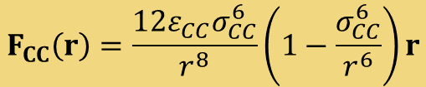


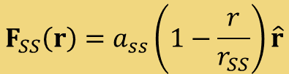
Interaction Forces
$$F_{CC}\left(r\right)=\frac{12ε_{CC}σ_{CC}^{6}}{r^{8}}\left(1−\frac{σ_{CC}^{6}}{r^{6}}\right)r$$
$$r<r_{CC}$$
$$F_{SC}\left(r\right)=\frac{12ε_{SC}σ_{SC}^{6}}{r^{8}}\left(1−\frac{σ_{SC}^{6}}{r^{6}}\right)r$$
$$r<r_{SC}$$
$$F_{SS}\left(r\right)=a_{ss}\left(1−\frac{r}{r_{SS}}\right)\hat{r}$$
$$r<r_{SS}$$

Slide 6
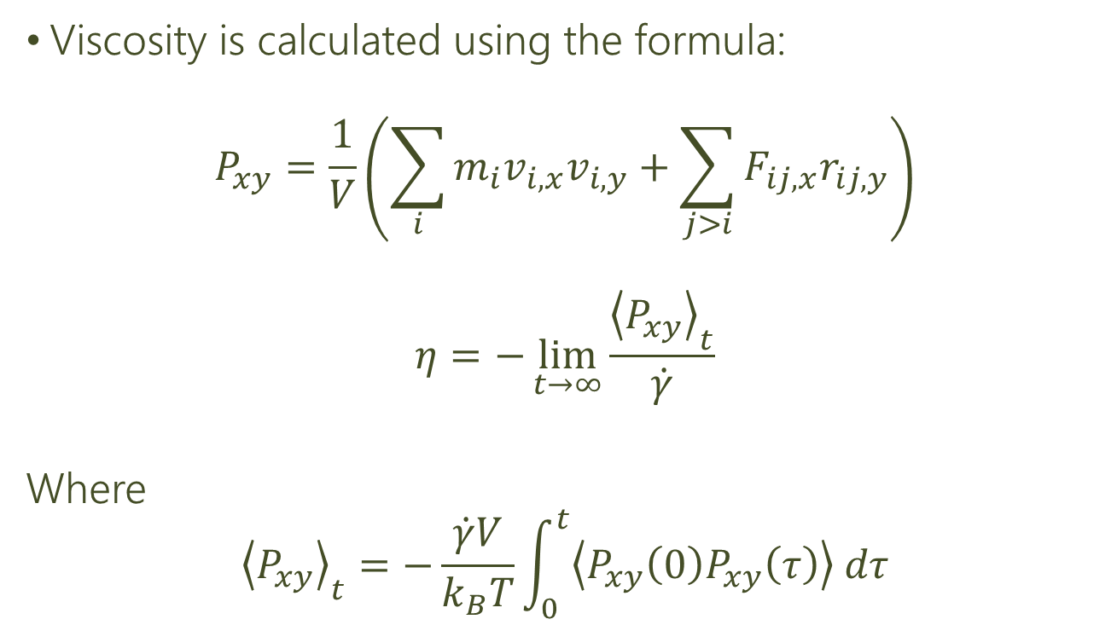
Calculation of Viscosity
Viscosity is calculated using the formula:
$$P_{xy}=\frac{1}{V}\left(\sum_{i}{m_{i}v_{i,x}v_{i,y}}+\sum_{j>i}{F_{ij,x}r_{ij,y}}\right)$$
$$η=−\lim_{t→∞}{\frac{{\left\langle P_{xy}\right\rangle }_{t}}{\dot{γ}}}$$
Where
$${\left\langle P_{xy}\right\rangle }_{t}=−\frac{\dot{γ}V}{k_{B}T}\int_{0}^{t}{\left\langle P_{xy}\left(0\right)P_{xy}\left(τ\right)\right\rangle dτ}$$

Slide 7
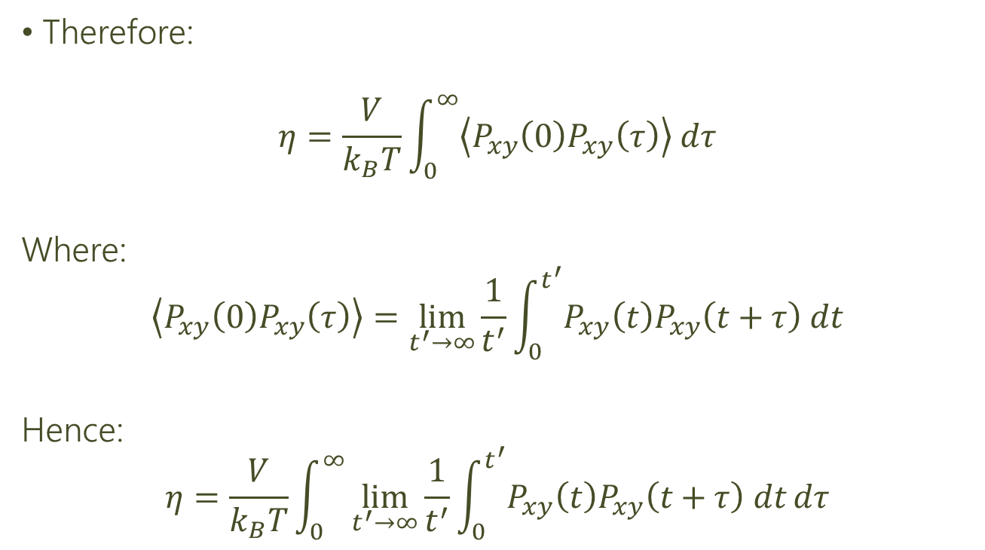
Calculation of Viscosity
Therefore:
$$η=\frac{V}{k_{B}T}\int_{0}^{∞}{\left\langle P_{xy}\left(0\right)P_{xy}\left(τ\right)\right\rangle dτ}$$
Where:
$$\left\langle P_{xy}\left(0\right)P_{xy}\left(τ\right)\right\rangle =\lim_{t^{′}→∞}{\frac{1}{t^{′}}}\int_{0}^{t^{′}}{P_{xy}\left(t\right)P_{xy}\left(t+τ\right) dt}$$
Hence:
$$η=\frac{V}{k_{B}T}\int_{0}^{∞}{\lim_{t^{′}→∞}{\frac{1}{t^{′}}}\int_{0}^{t^{′}}{P_{xy}\left(t\right)P_{xy}\left(t+τ\right) dt}dτ}$$

Slide 8
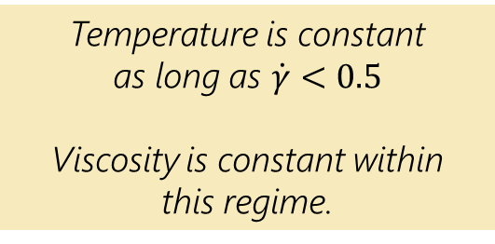
Variation of Shear Rate
Temperature is constant
as long as $\dot{γ}<0.5$
Viscosity is constant within
this regime.

Slide 9
Viscosity Measurements

Slide 10
Variation with particle number
Shear Rate: 0.1
Viscosity peaks sharply as we approach maximum packing density

Slide 11
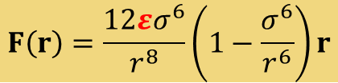
Variation of Repulsion Parameter
$$F\left(r\right)=\frac{12εσ^{6}}{r^{8}}\left(1−\frac{σ^{6}}{r^{6}}\right)r$$
Increasing repulsion parameter $ε$ increases viscosity
due to increased interaction forces

Slide 12
Variation of particle size
Changing size of particles while keeping fill fraction constant
Inconclusive: More runs needed

Slide 13
Mixed Particle Sizes

Slide 14
Colloid Particle Geometry

Slide 15
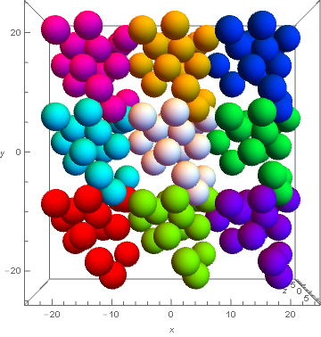
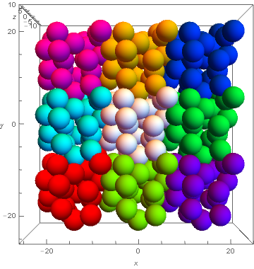
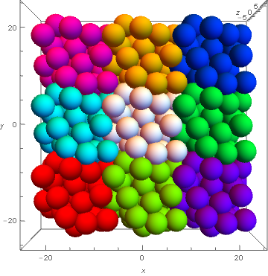
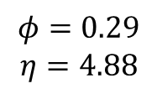
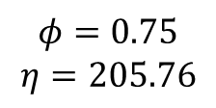
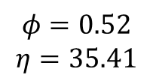
Fill Fraction
$$φ=0.29$$
$$η=4.88$$
$$φ=0.52$$
$$η=35.41$$
$$φ=0.75$$
$$η=205.76$$

Slide 16
Coordination Number

Slide 17
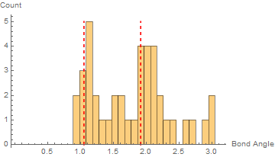
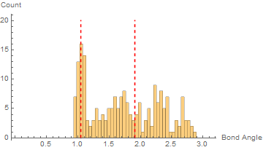
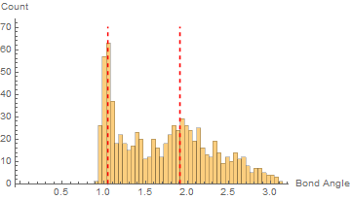
Bond Angle
Fill Fraction: 0.41
Coordination Number: 2.3
Fill Fraction: 0.52
Coordination Number: 4.1
Fill Fraction: 0.76
Coordination Number: 6.7

Slide 18
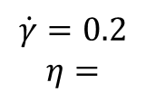
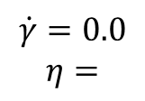
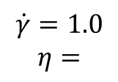
Shear Rate
$$\dot{γ}=0.0$$
$$η=$$
$$\dot{γ}=0.2$$
$$η=$$
$$\dot{γ}=1.0$$
$$η=$$

